Slide 1

JEEVAN (G-1) BIKE INSURANCE
We care for your Dream

Slide 2
Team Members
Abhishek Gandhi
Akalya Anbazhagan
Deepa Nigam
Nilesh Kumar Mangnani
Siddharth Sahu

Slide 3
Overview
Jeevan Insurance is a bike insurance company based in Talawade, Pune. Our company provides insurance for only two wheeler vehicles for specific models.
In our company we provide basic package in which we provide benefits to vehicles which have been damaged by accident (OD premium).

Slide 4
Brief Introduction about our company
JEEVAN INSURANCE IS A PRIVATE BIKE INSURANCE COMPANY STARTED IN 2017. IT DEALS WITH THE CLIENT FOR BIKE INSURANCE OF PREMIUM PER YEAR. A CLIENT GETS THE NCB(NO CLAIM BONUS) ONLY IF HE/SHE HAS NOT CLAIMED FOR INSURANCE IN PAST YEARS.
CALCULATION OF PREMIUM IS DONE ON THE BASIS OF FEW FACTORS LIKE DAMAGE CAUSED TO THE VEHICLE, YEAR INSURED AND FEW OTHER FACTORS.
CLIENT CAN BROWSE HIS DETAILS AND TERMS AND CONDITIONS OF THE COMPANY IN SEPEARTE SECTIONS. EVERY CLIENT HAS BEEN PROVIDED WITH A UNIQUE LOGIN ID AND PASSWORD.

Slide 5
Business Requirements
Its primary requirement is to provide financial protection against physical damage or bodily injury resulting from traffic collisions and against liability that could also arise there from. The specific terms of vehicle insurance vary with legal regulations in each region.
Only for Two Wheelers :
We are providing Insurance only on particular models such as Pulsar 150, Pulsar 200, Pulsar 220, of Talawade, Pune.
Only for Three Years :
The vehicle which is registered after 2015 will be eligible for 3 years Insurance.
Only On Damage :
We will give claim to vehicles according to their condition after accident (no claim for Liability).
No Claim Bonus (NCB) :
We will provide bonus to our clients who has not claimed in past years which will be deducted from the OD premium.

Slide 6
Calculation of Premium
IDV (Insured Damage Value) = 0.8 * Price of bike (if start date – registration date = 0)
= 0.6 * Price of bike (if start date – registration date = 1)
= 0.4 * Price of bike (if start date – registration date = 2)
Assumption, Price of bike is getting reduced by 20% per year.
OD = IDV * 2%
Where, 2% = Premium rate.
Total OD = OD-NCB
Where NCB = 20% * OD (NCB =0 when no. of claims > 0)
Tax = 12% of Total OD.
Premium will be calculated by given formula:-
Total premium = OD – NCB + TAX

Slide 7
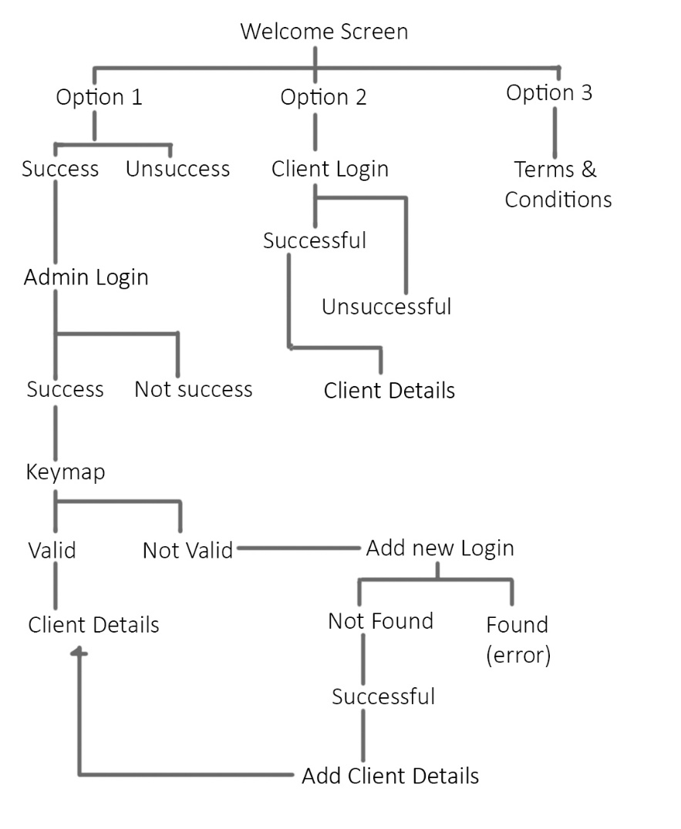
Sequence Diagram

Slide 8
Technical Specifications
Components name | Type
P05AP01 | CICS (COBOL)
P05AP02 | CICS (COBOL)
P05AP03 | CICS (COBOL)
P05AP04 | CICS (COBOL)
P05AP05 | CICS (COBOL)
P05AP07 | CICS (COBOL)
REP 1 | COBOL
REP 2 | COBOL
P05AS01 | CICS
Components Name | Type
ADMIN | DB2
BIKE | DB2
CLIENT1 | DB2
CLIENT2 | DB2

Slide 9
Technical Specifications (Contd…)
File Types | No. of files
Cobol (CICS + COBOL) | 8
CICS (Mapset) | 1
DB2 | 4

Slide 10
Welcome Screen
Test Result
DEEPA

Slide 11
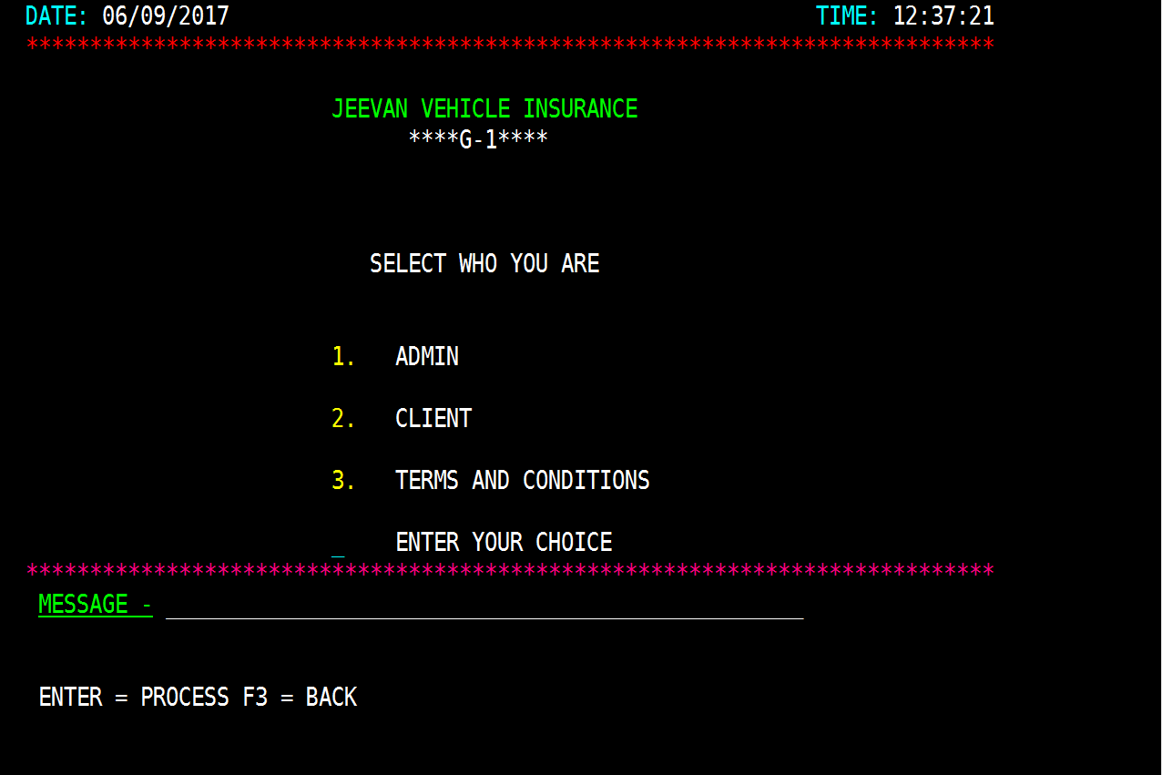
Test Result
Welcome Screen
After Pressing an Enter key with a valid choice (Option 1,2,3)

Slide 12
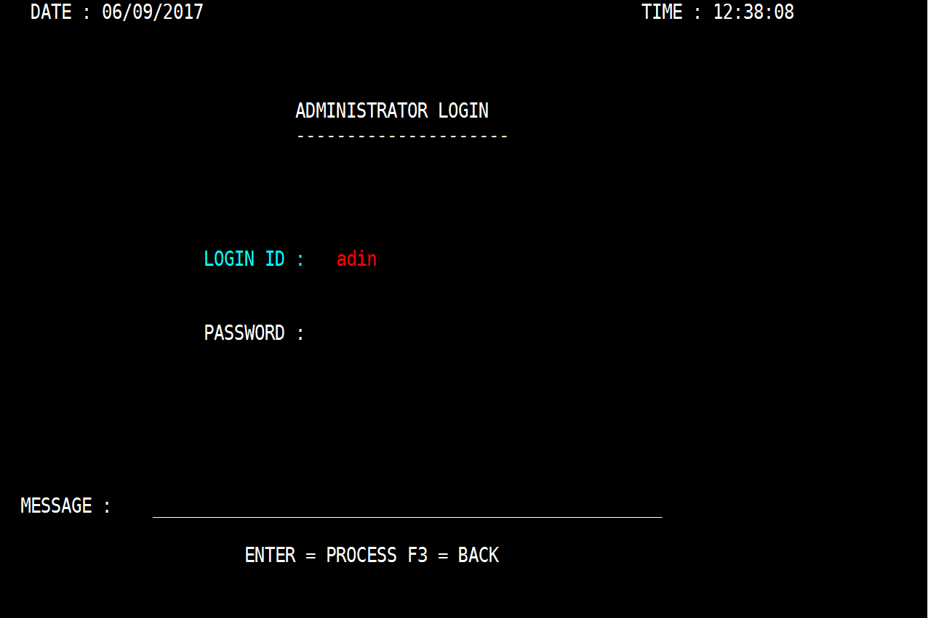
Expected Results
Option 1:- Go to admin login.

Slide 13
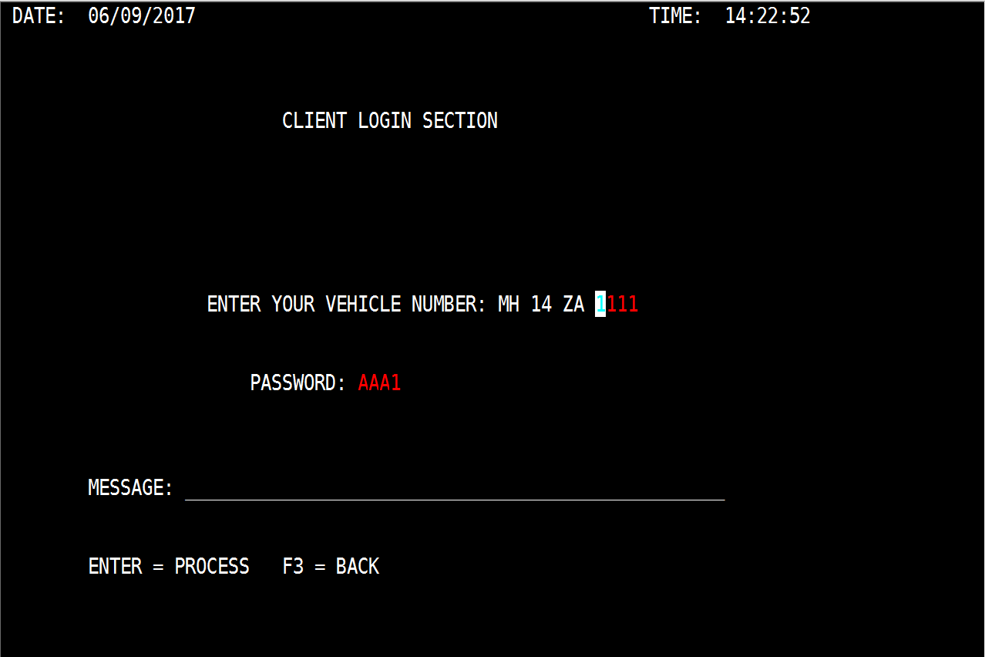
Option 2:- Go to client login.

Slide 14
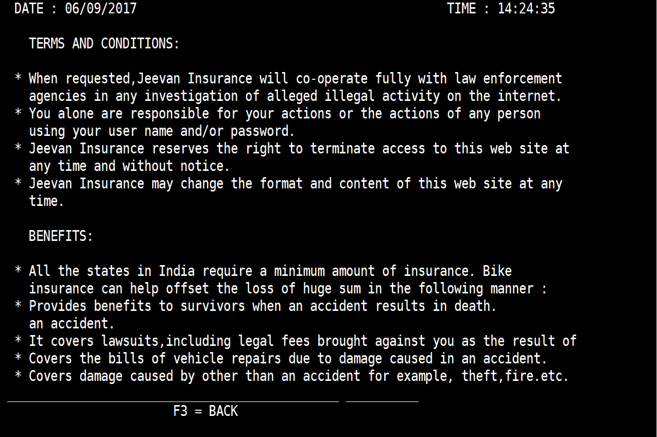
Option 3:- Go to Terms & Conditions screen

Slide 15
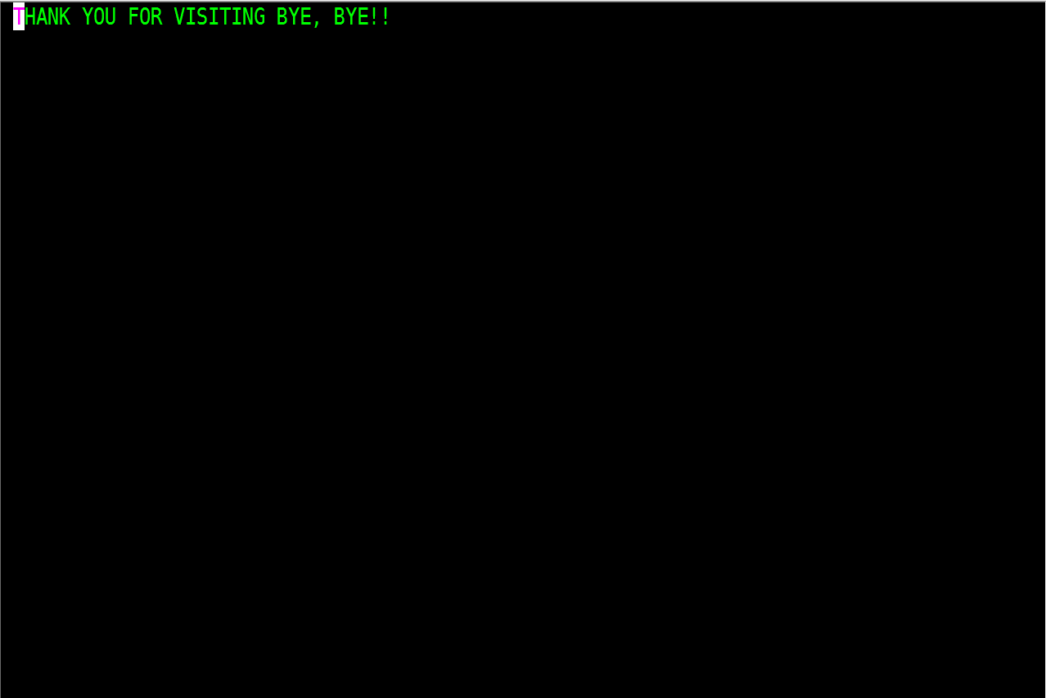
Option 4:- Pressing F3 will end the program.

Slide 16
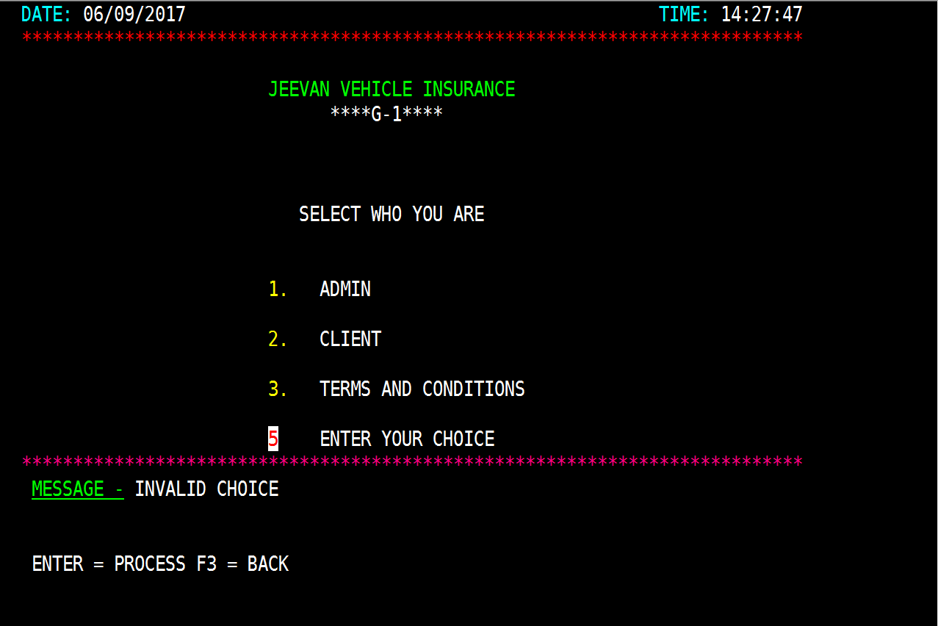
Option 5:- Pressing any other AID keys or choosing wrong options will give an error message.
Actual Results

Slide 17
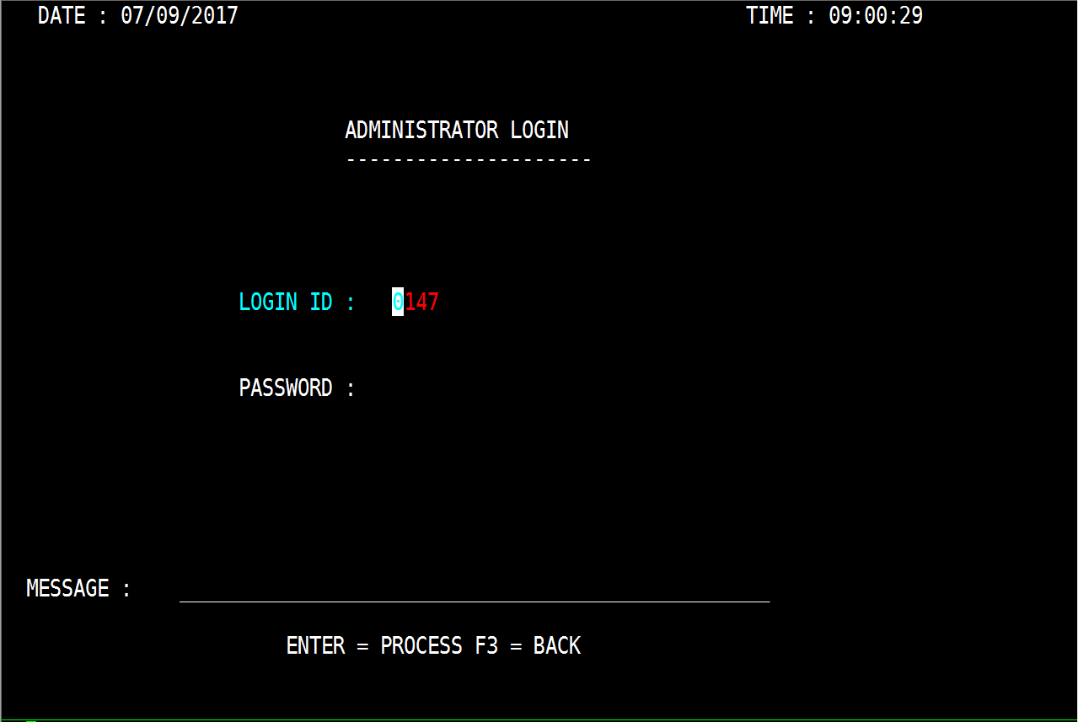
Actual Results
Option 1:- Go to admin login.
Result= Pass

Slide 18
Option 2:- Go to client login.
Result= Pass

Slide 19
Option 3:- Go to Terms & Conditions screen
Result= Pass

Slide 20
Pressing F3 will end the program.
Result = Pass

Slide 21
Pressing any other AID keys or choosing wrong options will give an error message
Result = Pass

Slide 22
Admin Login Screen
Test Result
ABHISHEK

Slide 23
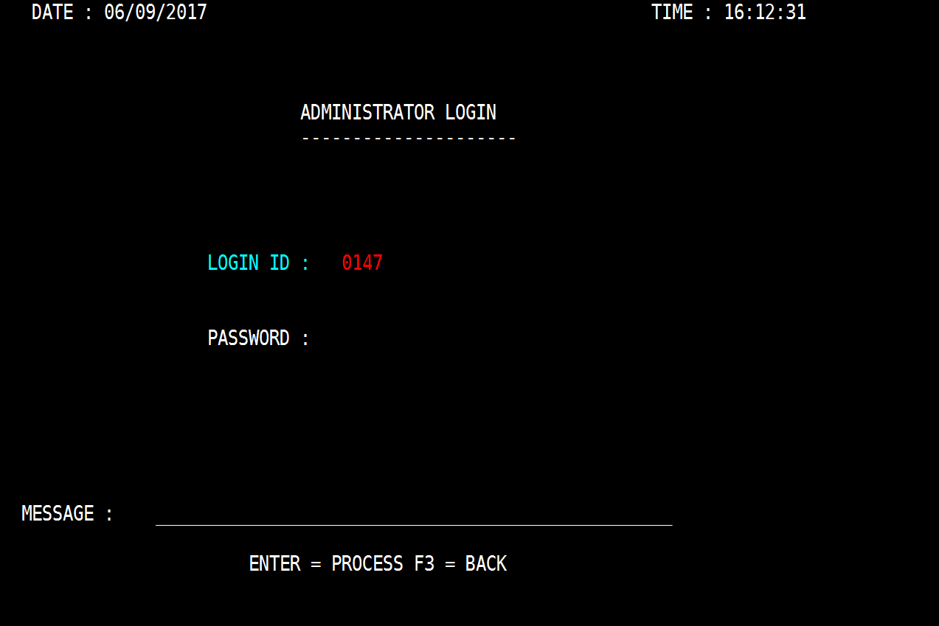
Admin Login Screen
Expected Result

Slide 24
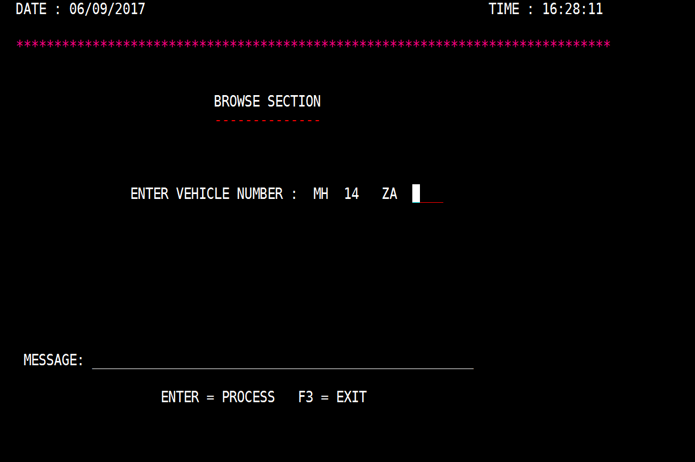
Pressing an Enter key with a valid id and password will go to key map to accept vehicle number.

Slide 25
Pressing F3 will go to welcome screen.

Slide 26
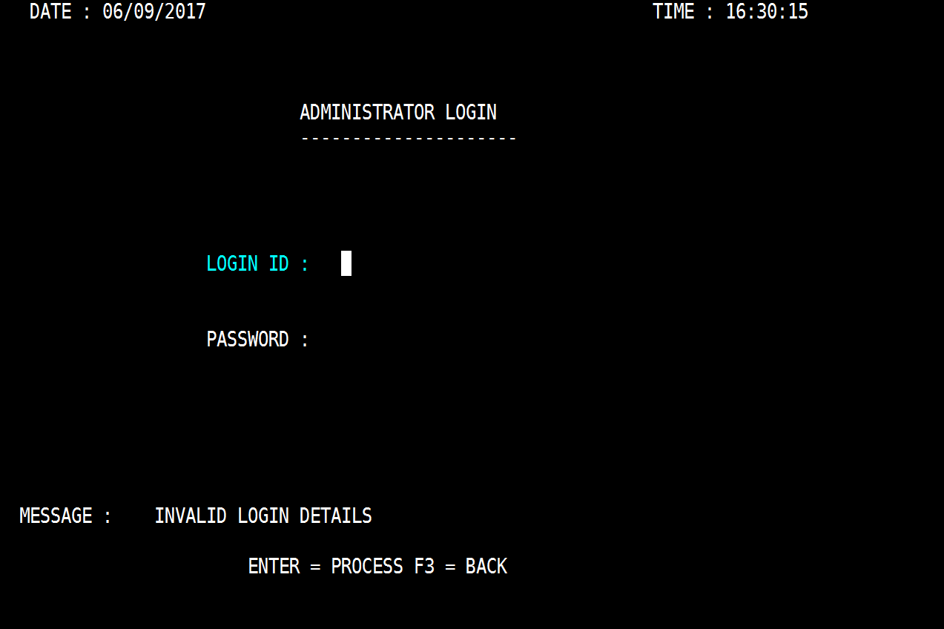
Pressing any other AID keys or choosing invalid id and password will give an error message.

Slide 27
Actual Results
Pressing an Enter key with a valid id and password will go to key map to accept vehicle number.
Result = Pass

Slide 28
Pressing F3 will go to welcome screen.
Result = Pass

Slide 29
Pressing any other AID keys or choosing invalid id and password will give an error message.
Result = Pass

Slide 30
Browse Section Screen
Test Result
SIDDHARTH

Slide 31
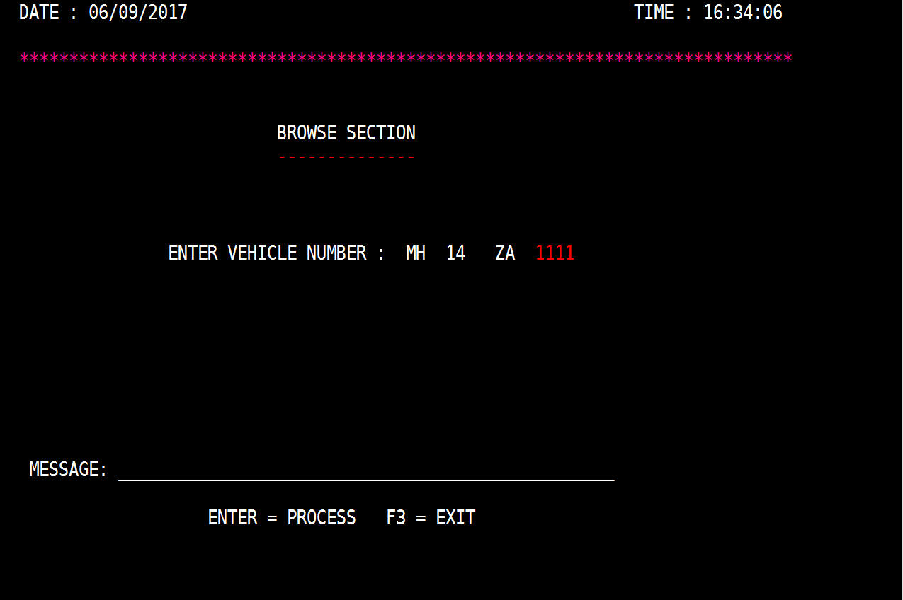
Browse Section Screen (with input)

Slide 32
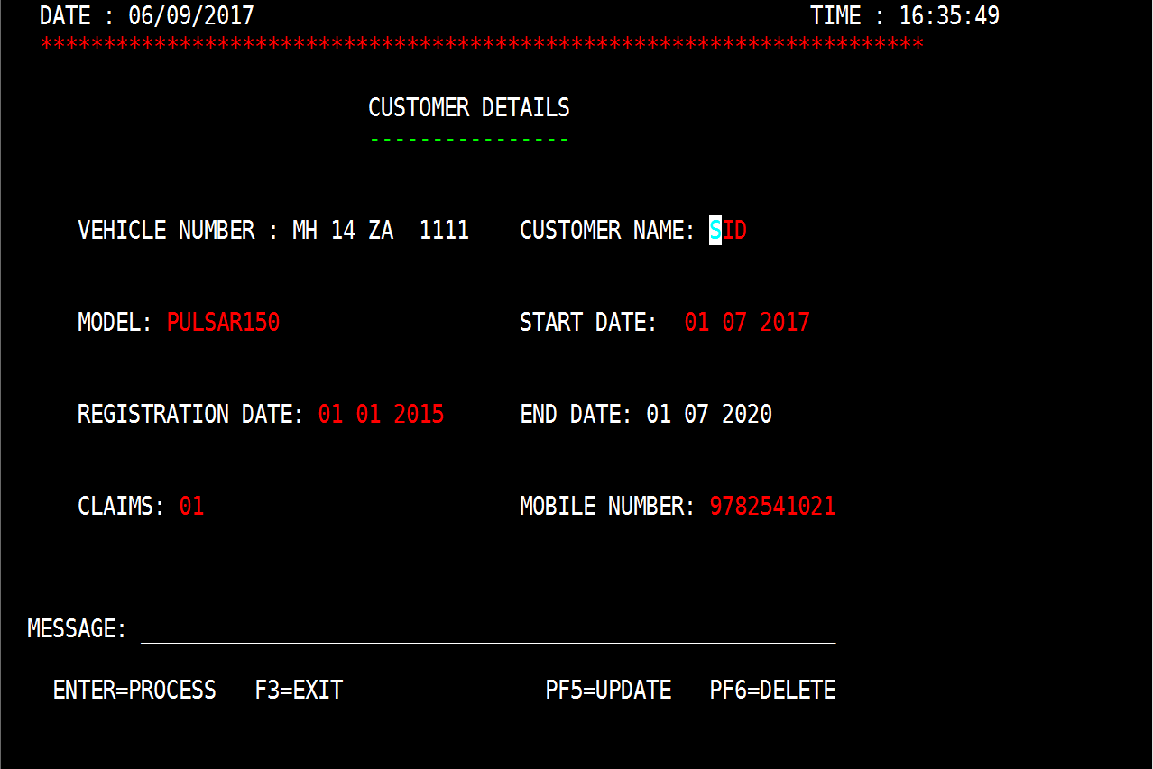
Expected Result
Pressing an Enter key with a valid vehicle number will go to detail map to update or delete the information.

Slide 33
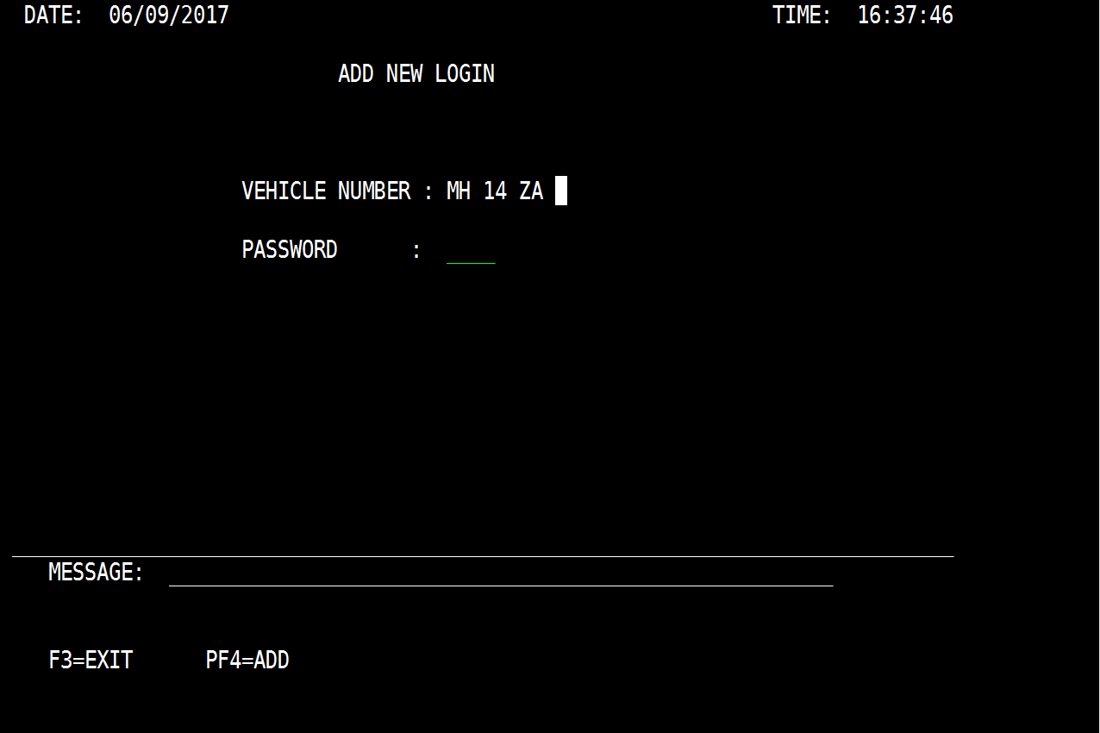
Pressing an Enter key with a invalid vehicle number will go to add new login screen.

Slide 34
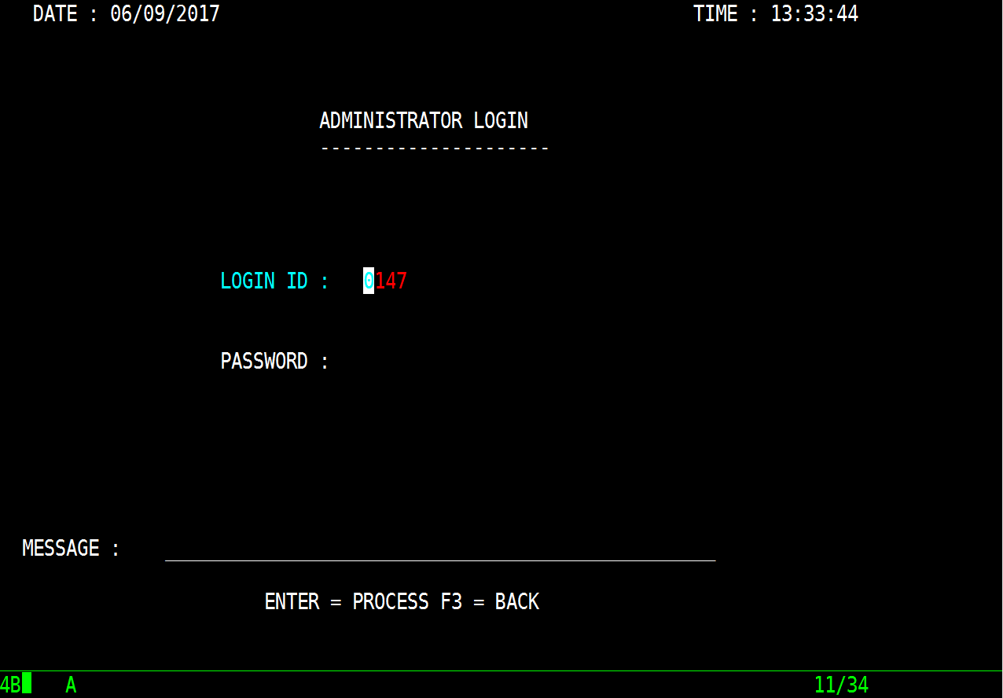
Pressing F3 will go to Admin login screen.

Slide 35
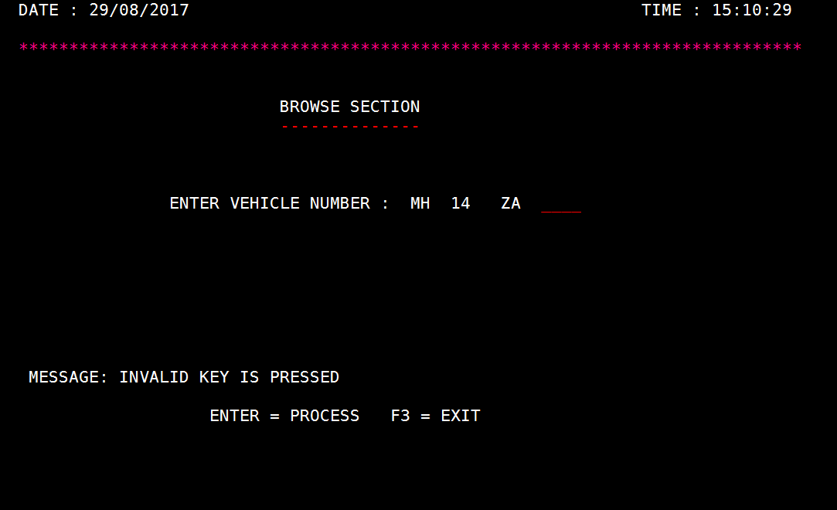
Pressing any other AID keys error message.

Slide 36
Actual Result
Pressing an Enter key with a valid vehicle number will go to detail map to update or delete the information.
Result - Pass

Slide 37
Pressing an Enter key with a invalid vehicle number will go to add new login screen.
Result = Pass

Slide 38
Pressing F3 will go to admin login screen.
Result = Fail

Slide 39
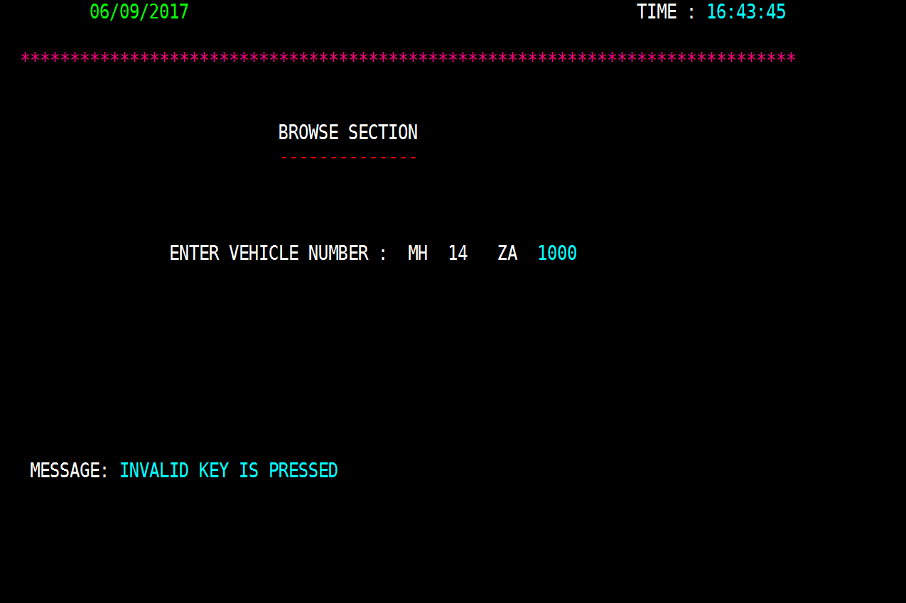
Pressing any other AID keys error message.
Result = Pass

Slide 40
Detail Screen Section
Test Result
SIDDHARTH

Slide 41
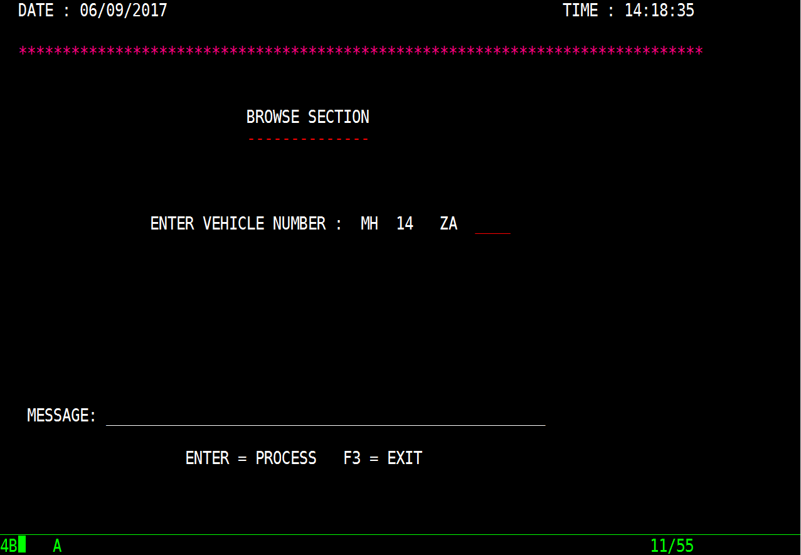
Detail Screen:-
Expected Results
Pressing F3 will go to browse section.

Slide 42
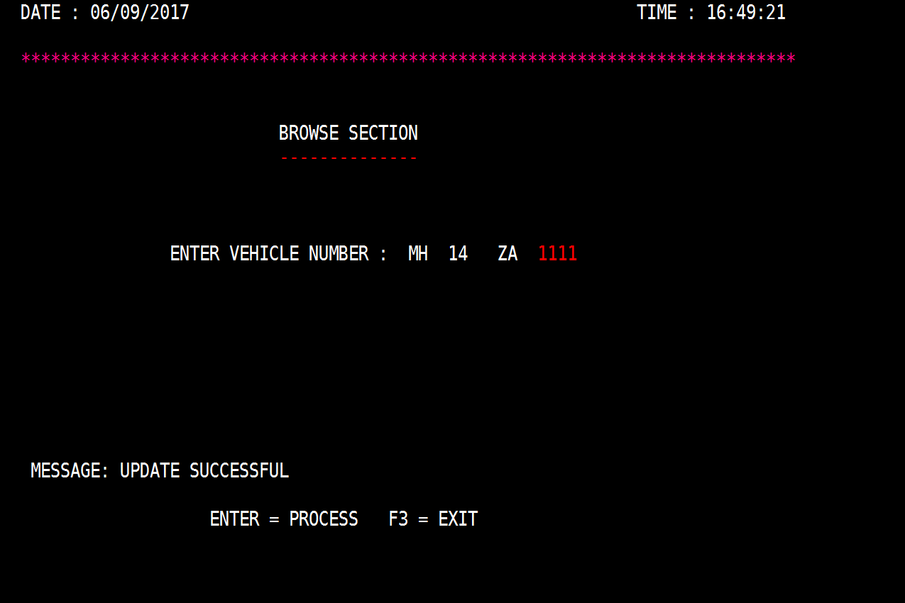
Pressing F5 will update the data and go to browse section giving the some message.

Slide 43
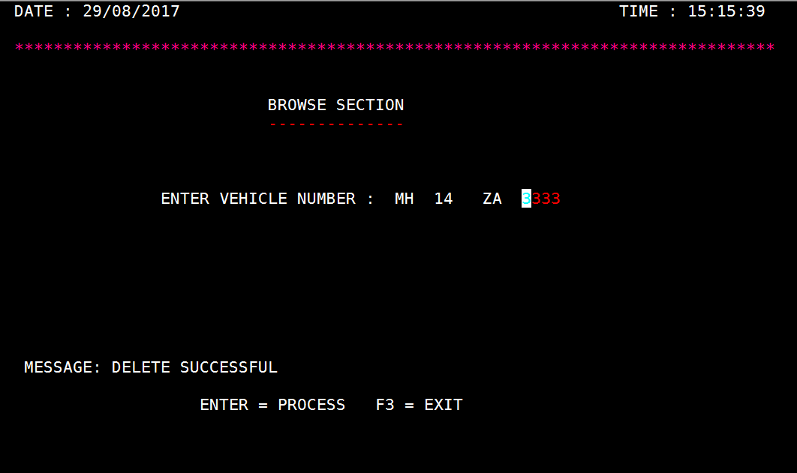
Pressing F6 will delete the data and go to browse section giving some message.

Slide 44
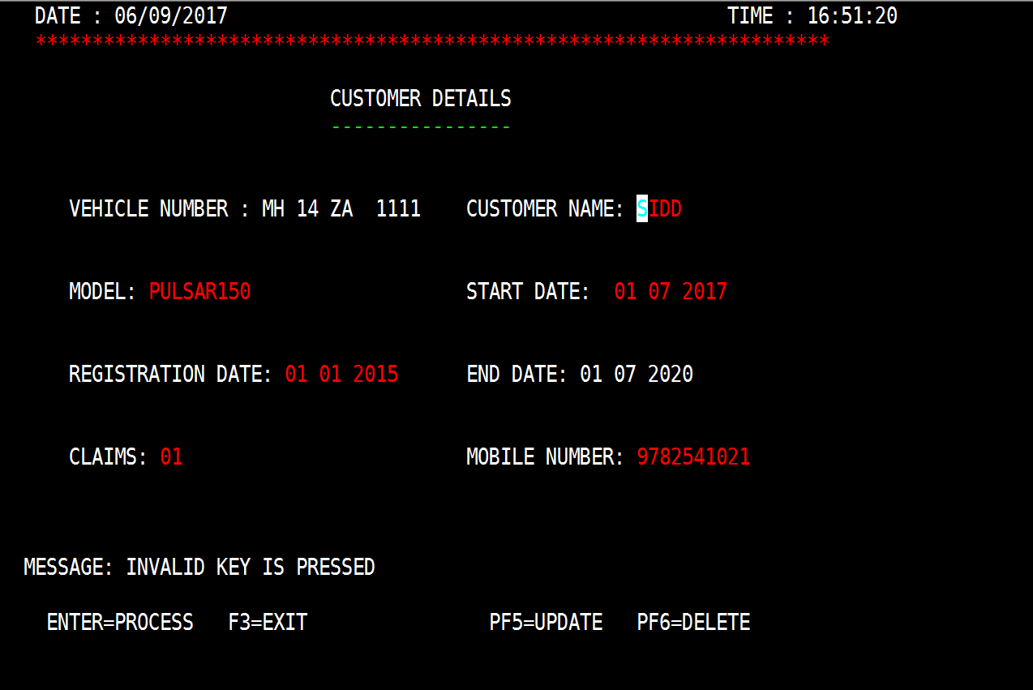
Pressing any other AID keys will give an error message

Slide 45
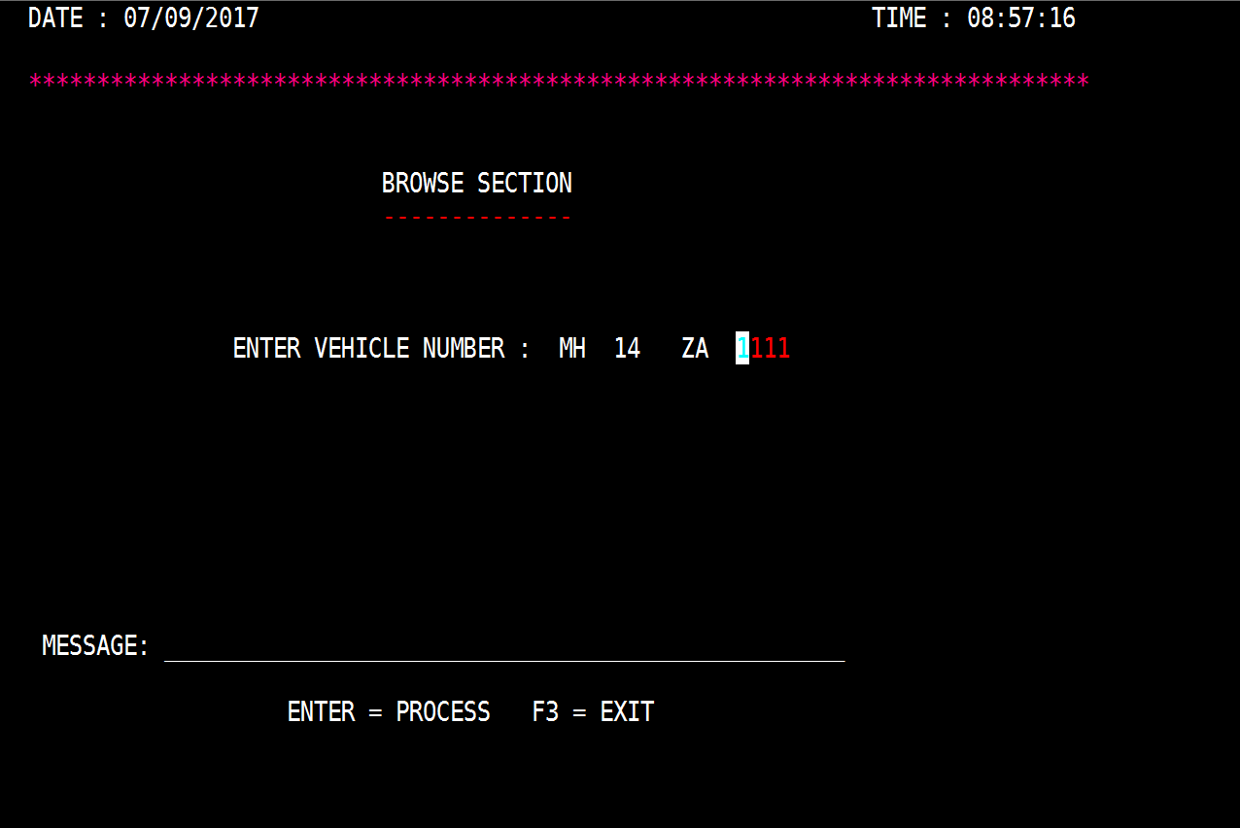
Actual Results
Pressing F3 will go to browse section.
Result = Pass

Slide 46
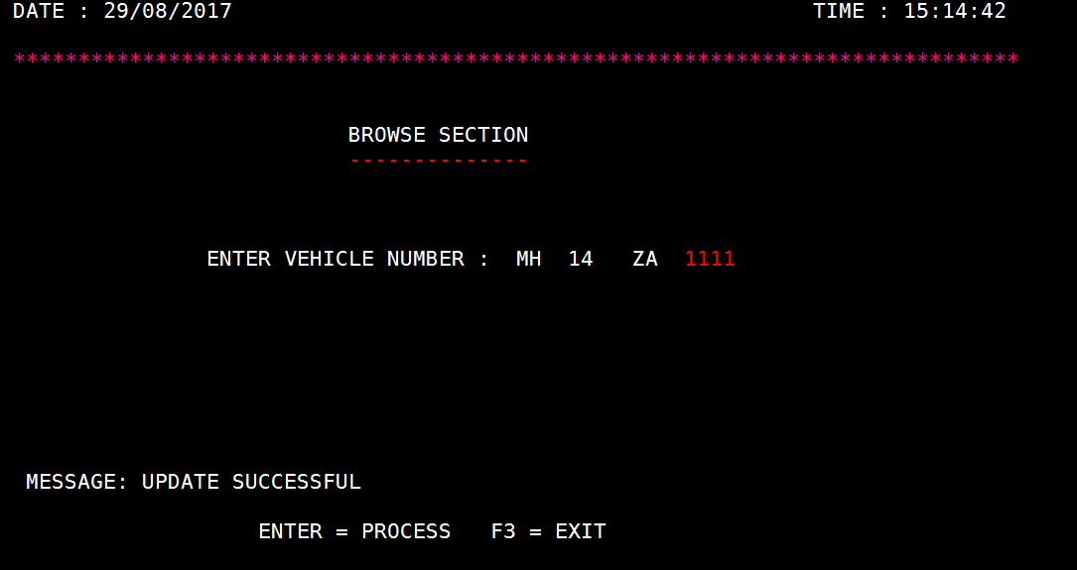
Pressing F5 will update the data and go to browse section giving the some message.
Result = Pass

Slide 47
Pressing F6 will delete the data and go to browse section giving some message.
Result = Pass

Slide 48
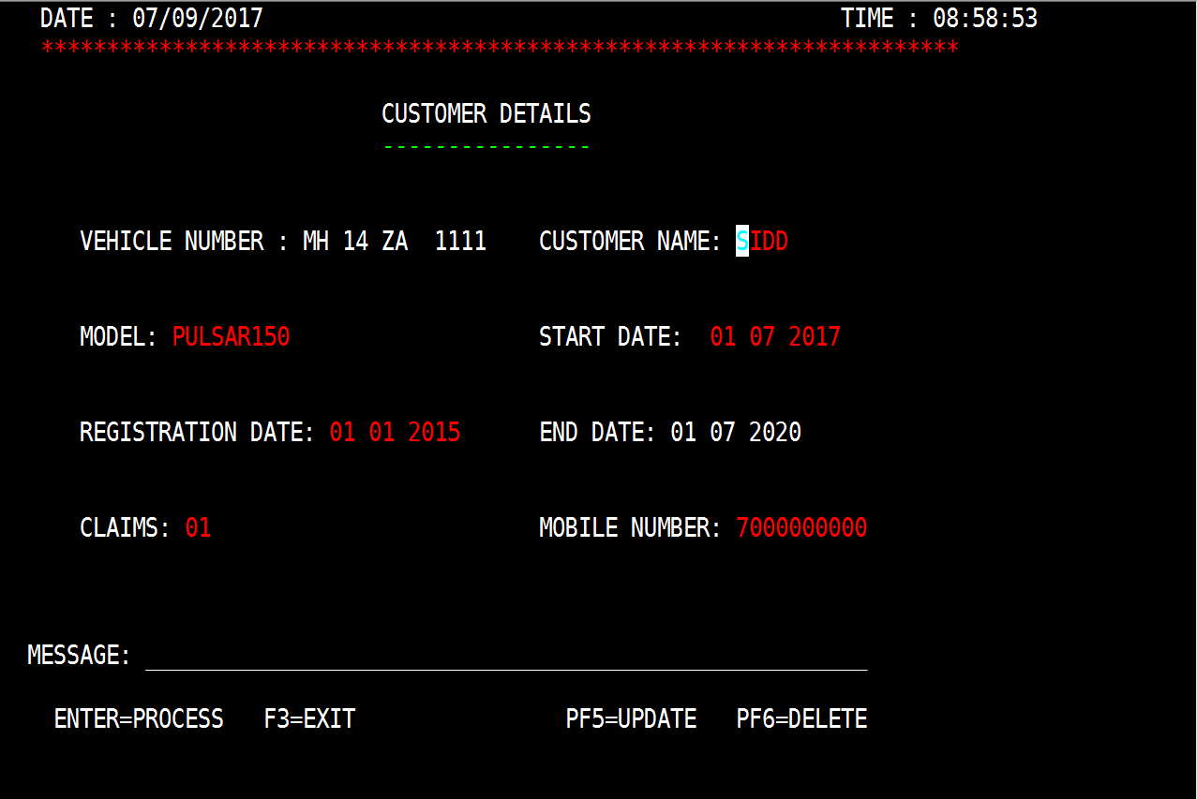
Pressing any other AID keys will give an error message
Result = Pass

Slide 49
Add New Login Section
Test Result
DEEPA

Slide 50
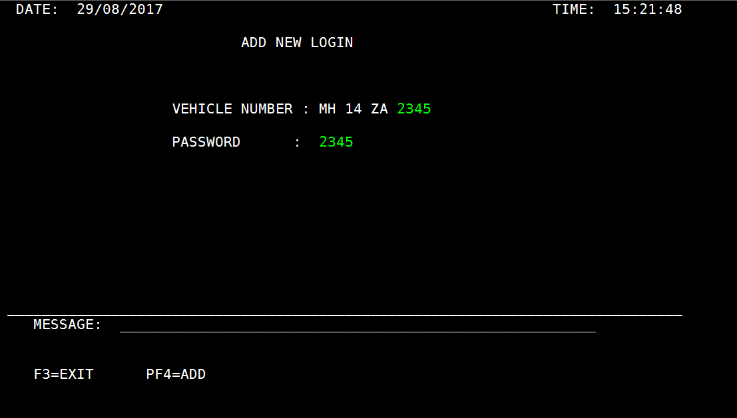
Add New Login Screen (With Inputs) :-

Slide 51
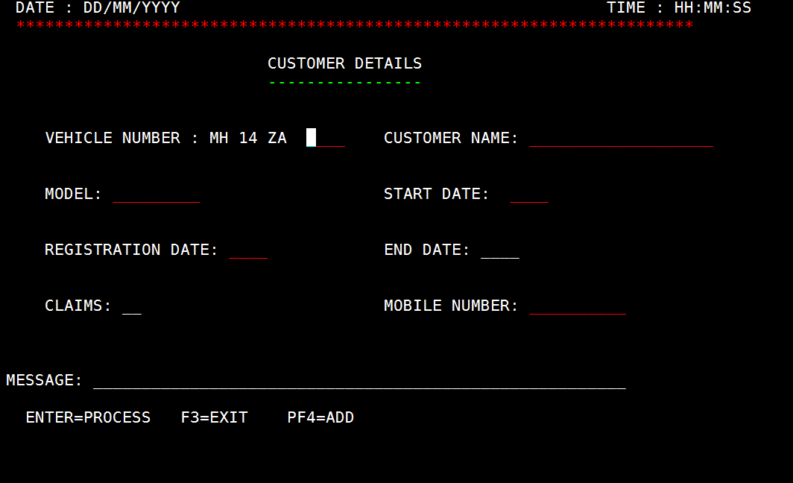
Expected
Pressing an F4 key with a valid id and password will go to Add detail map(DETAILD).

Slide 52
Pressing F3 will go to Browse Section

Slide 53
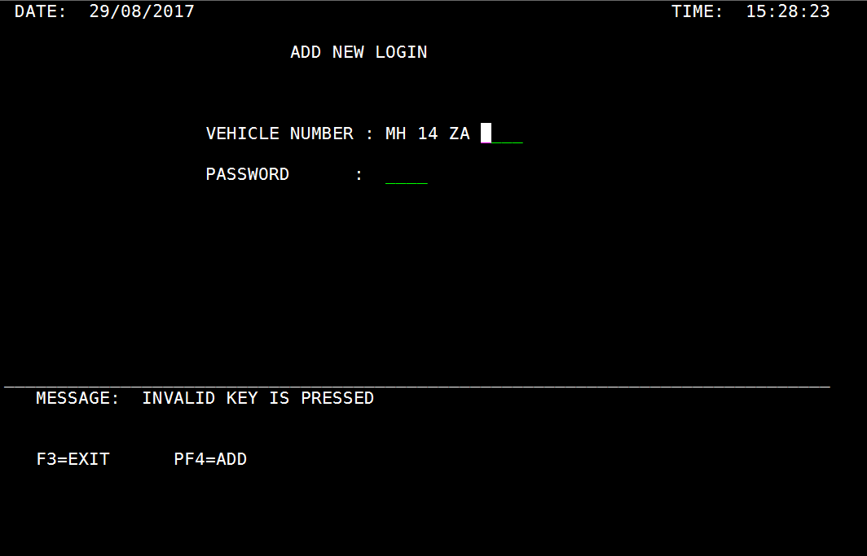
Pressing any other AID keys will give an error message.

Slide 54
Actual
Pressing an F4 key with a valid id and password will go to Add detail map (DETAILD).
Result- Pass

Slide 55
Pressing F3 will go to Browse Section
Result- Pass

Slide 56
Pressing any other AID keys will give an error message.
Result- Pass

Slide 57
Add Detail Screen
Test Result
SIDDHARTH

Slide 58
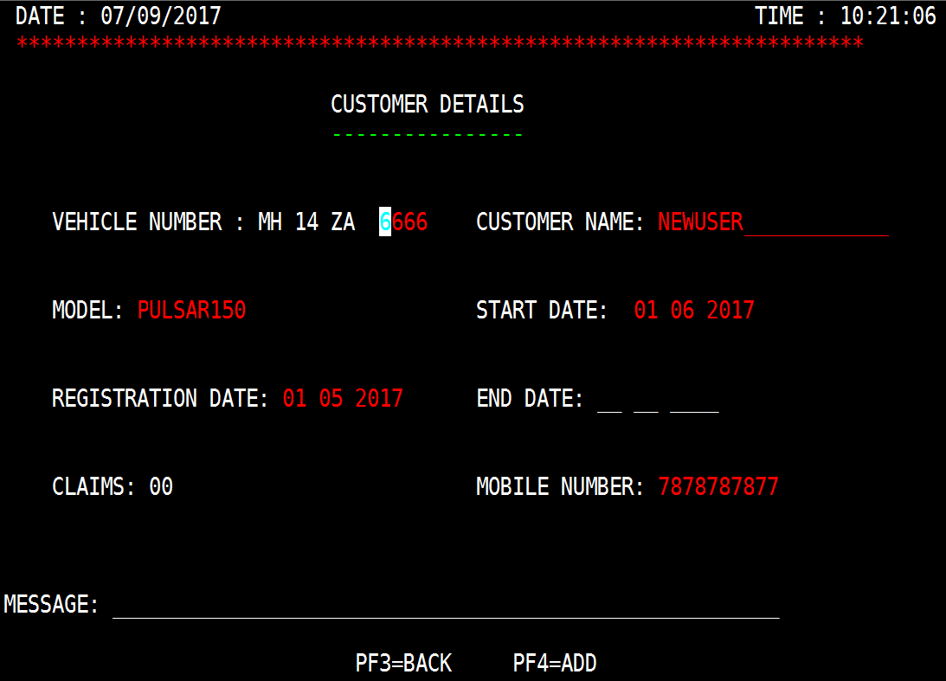
Add Detail Screen:-
INPUT -

Slide 59

Expected Results
Pressing F4 will add details of new customer and go to browse section

Slide 60
Pressing F3 will go to browse section.

Slide 61
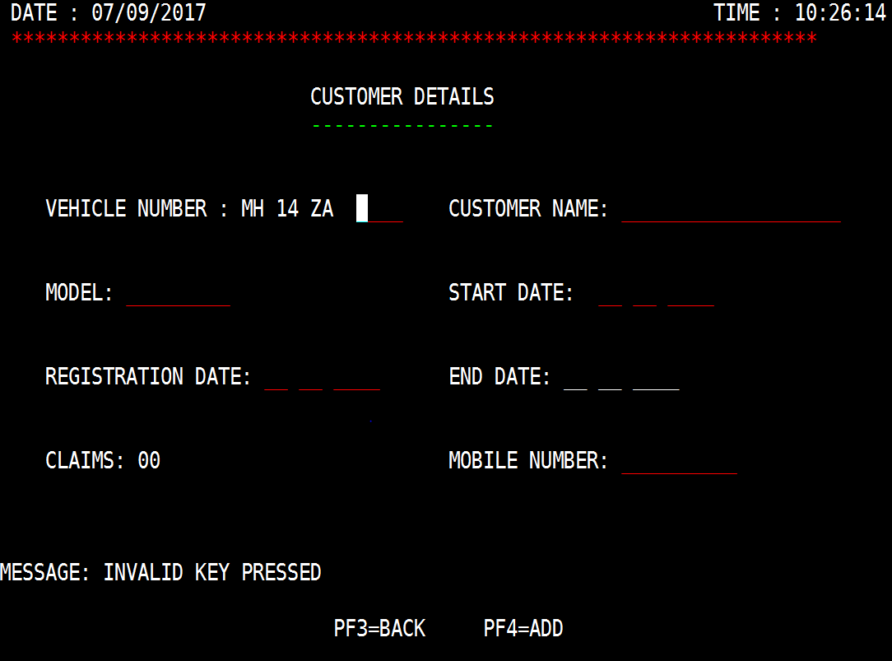
Pressing any other AID keys will give an error message.

Slide 62
Actual Results
Pressing F4 will add details of new customer.
Result = Pass

Slide 63
Pressing F3 will go to browse section.
Result = Pass

Slide 64
Pressing any other AID keys will give an error message
Result = Pass

Slide 65
Client Login Section
Test Result
NILESH

Slide 66
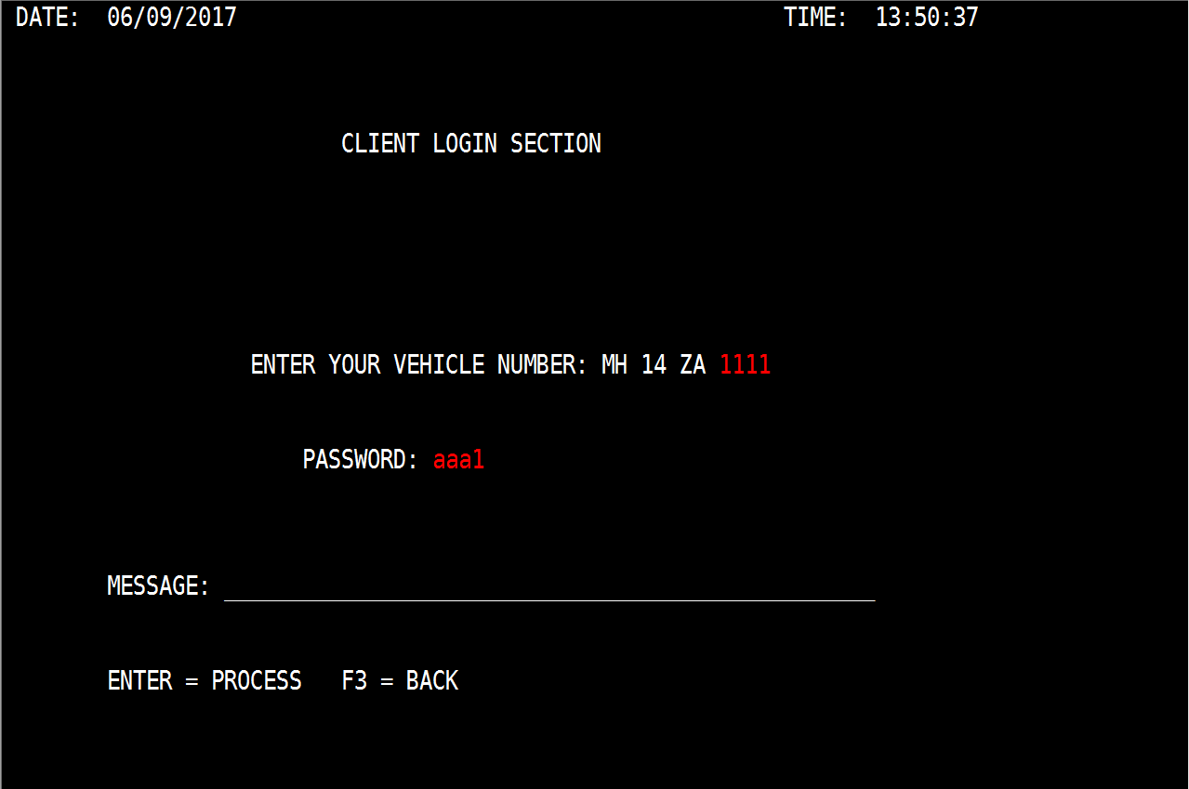
Client Login Screen (With Inputs) :-

Slide 67
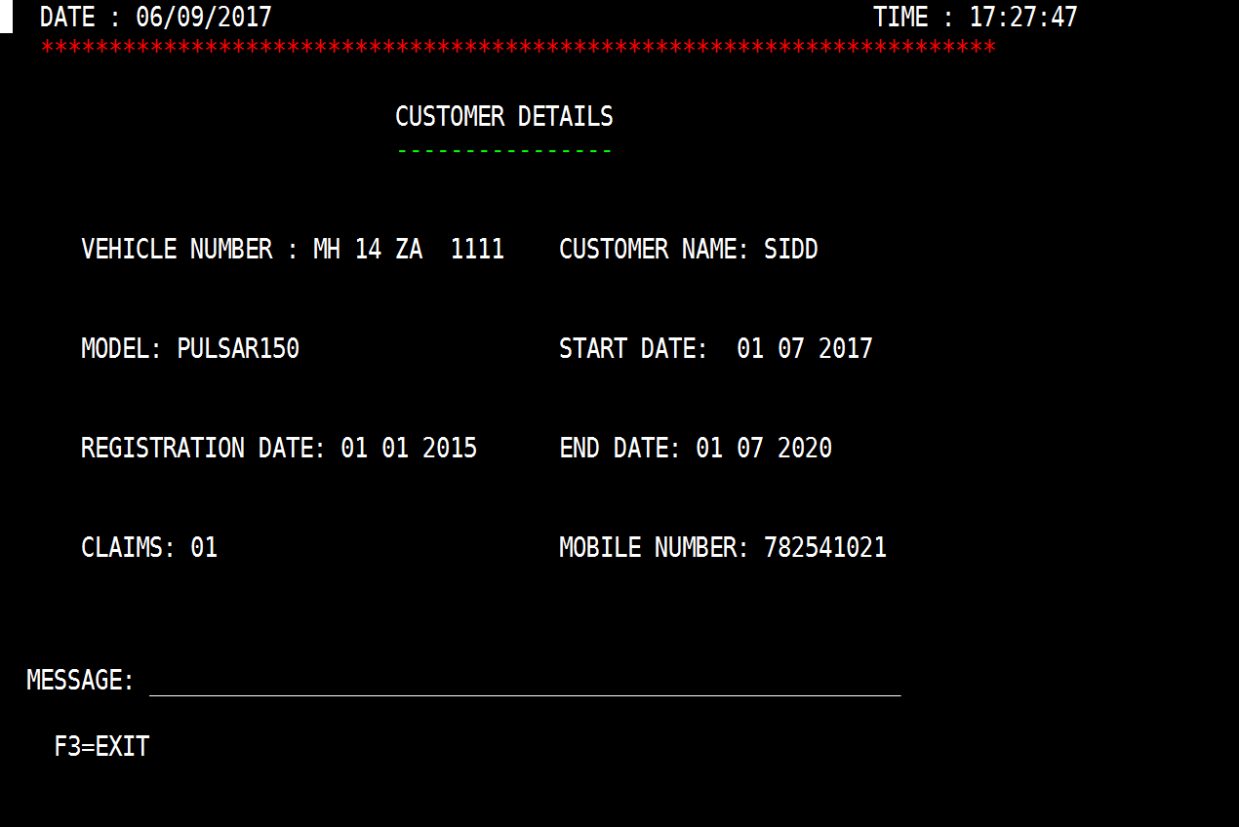
Expected
Pressing an Enter key with a valid id and password will go to browse map to show the customer details.

Slide 68
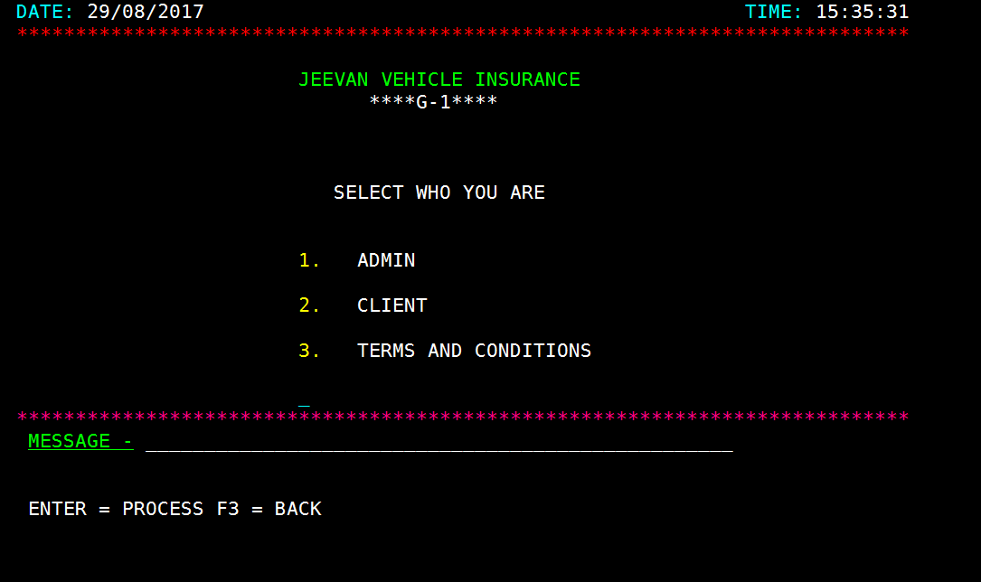
Pressing F3 will go to welcome screen.

Slide 69
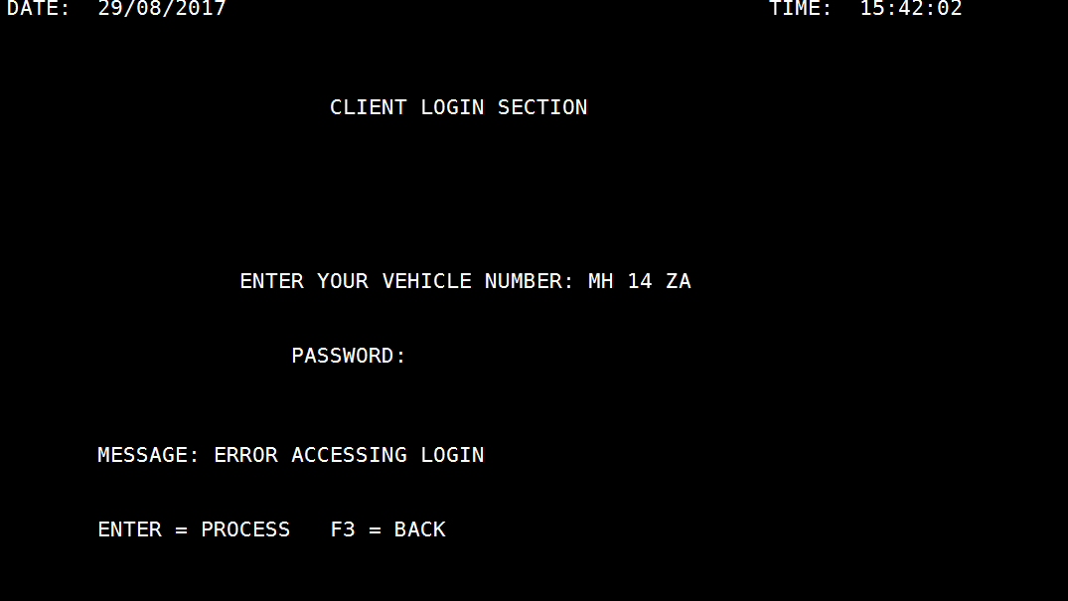
Pressing any other AID keys or choosing invalid id and password will give an error message.

Slide 70
Actual
Pressing an Enter key with a valid id and password will go to browse map to show the customer details.
Result - Pass

Slide 71
Pressing F3 will go to welcome screen.
Result = Pass

Slide 72
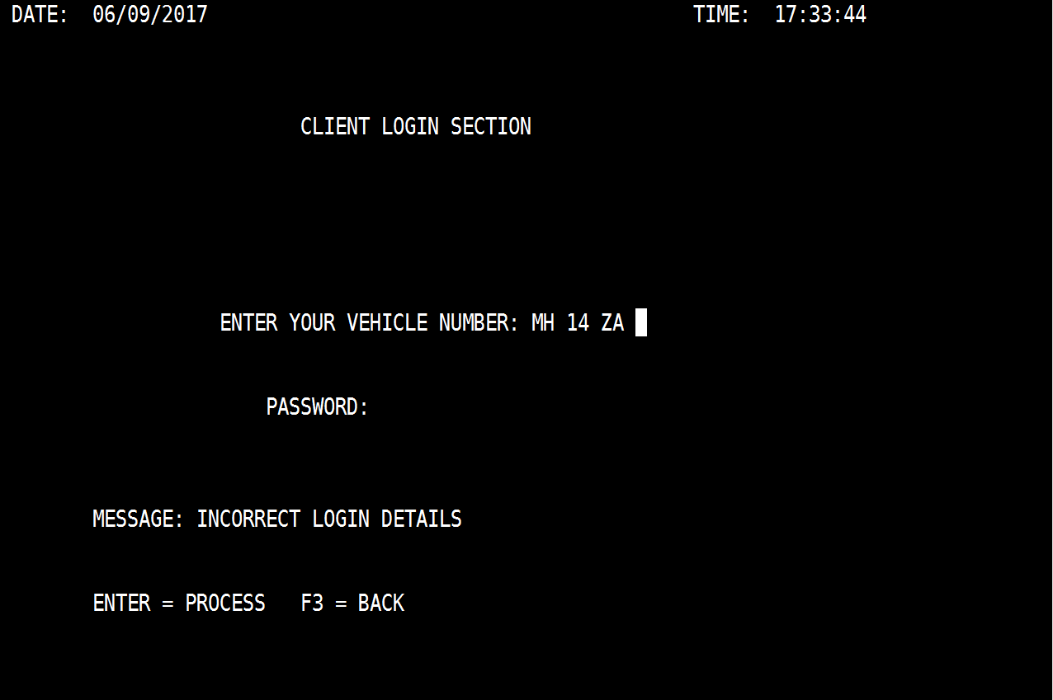
Pressing any other AID keys or choosing invalid id and password will give an error message.
Result = Pass

Slide 73
Terms and Condition Section
Test Result
AKALYA

Slide 74
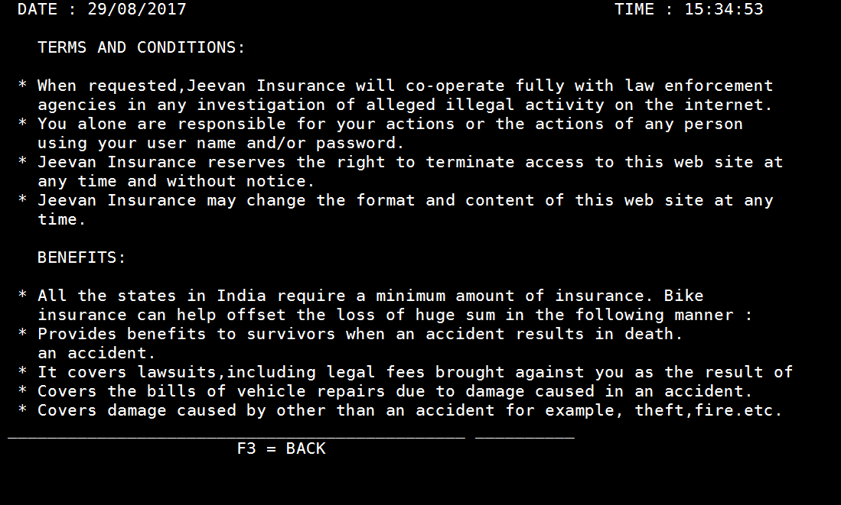
Expected Results
. Terms and Conditions Screen:-

Slide 75
Pressing F3 will go to welcome screen.

Slide 76
Actual Results
Pressing F3 will go to welcome screen.
Result - Pass

Slide 77
Pressing any other AID keys the screen will remain same.
Result - Pass

Slide 78
Our application
We also have an application in which we provide information to our clients about there vehicle insurance.
This application is for two types of people, one is Administrator who can Add, Update, Delete or Browse Clients data, and other is client who can only browse his/her data.
By our application clients can view the information of there vehicles such as registration year, number of claims, expiry year, etc.

Slide 79
Assumptions Made In Our Applications
INSURANCE COMPANY- JEEVAN (G-1) INSURANCE.
ONLY FOR BIKE INSURANCE OF 3-4 MODELS.
ONLY CLIENT AND ADMIN ACCESS.
ON DAMAGE PREMIUM IS CALCULATED ON THE BASIS OF REGISTRATION DATE OF VEHICLE AND STARTING DATE OF INSURANCE.
INSURANCE IS ONLY FOR 3 YEARS.

Slide 80
Assumptions (continue)
CLAIM DATE IS GREATER THAN THE COMPANY OPENING DATE AND BIKE PURCHASE DATE.
PREMIUM IS CALCULATED PER YEAR AND IS TO BE PAID BY THE CLIENT (THROUGH OFFLINE PROCESS).
BENEFIT IS PROVIDED WHEN THERE IS ANY DAMAGE TO THE BIKE.

Slide 81
Validations Used In Our Application
Mobile numbers should be of 10 numbers only.
The First Three column of Vehicle number are static and last column contains 4 numbers.
Date should be numeric, and registration date should not be less than 2015.
The date of claiming the vehicle should be greater then starting date of insurance.
The period of starting date and ending date should be 1 year.
Vehicle Number should be numeric, non spaces, non-zero and should contain only 4 digits.
Customer name should not be numeric and non-zero.
Model number should be 150, 200, 220.
Model number should not contain any spaces or zeros.

Slide 82
Code Review (Done by G-2)
Test Result:-
No Author name is given in any of the programs.
Comments are not given in Rep1 and Rep2.
Variable Names are bit complicated in Rep2.
Good coding standards are followed.
Validations are partial.
Spaces are not given after paragraphs, hence not properly readable.

Slide 83
THANK YOU

